Slide 1
Synthetic Data in Healthcare
Team 3
Addie Puskar, Yuqian Liu, Cameron Spangler, Richard Loftis

Slide 2
Agenda
Problem Statement
Research Paper Discussion
Code Demo
Ethical Concerns
Future Developments and Concerns

Slide 3
Problem Statement
To investigate the potential of synthetic data in addressing data-related challenges in healthcare and evaluate its quality and utility in improving the performance and generalizability of AI models in healthcare applications. This includes developing best practices for generating and using synthetic healthcare data and comparing its performance to real-world healthcare data to ensure its reliability and effectiveness.
Notes:
Combines the advantages of other algorithms for sparse gradients and non-stationary settings. Also has the advantage of ease of implementation. A good example is the demo Dr. Chung conducted in class with machine learning between the banana and the coin. Adam allows for faster learning at a lower cost. Disadvantages of stochastic gradient descent is it requires a number of hyperparameters, and is sensitive to feature scaling.
Richie definition:
Stochastic Gradient Descent is a method of training a model where the cost function of a model is minimized by taking sequential steps from a random intercept and beta coefficient(s) until the loss minimizing values are found.

Slide 4
What is Synthetic Data?
Computer generated data for model testing and training
Can substitute for multiple mediums of data (text, images, etc)
Can make data collection process more inexpensive, quicker
Has ability to protect the privacy of those sampled

Slide 5
Research Paper Discussion
Dahmen, J.; Cook, D. SynSys: A Synthetic Data Generation System for Healthcare Applications. Sensors 2019, 19, 1181. https://doi.org/10.3390/s19051181
Smart home: tracked more detailed daily activity and health data
Infrared motion sensors: activate when heat-based movement occurs
Door sensor: activate when door is open or close
Notes:
First research paper we picked discussed a synthetic data generation system in healthcare industry.
In paper, they discuessed how this system can be used to generate smart home data, which is closely related to healthcare.
smart home devices can access more detailed and overall health data from two kinds of sensors when you stay at home
Convenient for patient accessing care from providers

Slide 6
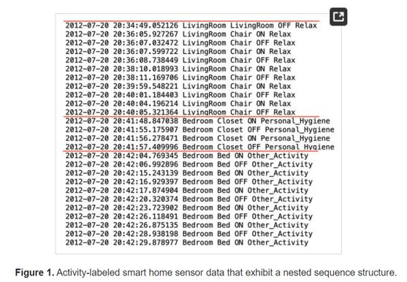
Notes:
Here is an example of activity log of smart home sensor generated
First part is time;
Second part is the location: bedroom/ livingroom; this part also has the a specific detail: in the bedroom, whether just stayed in the livingroom or stayed in the chair;
On and off indicated the beginning and end of sensor detect the human in motion
Last part is what kind of activity a person is doing: for example, relax or personal hygience
Each sensor event contains the event timestamp, the sensor name, the sensor state and the activity label

Slide 7
How to build
HMM (hidden Markov Models): a statistical model used to describe the probability distribution of a sequence of observations
1. Train a HMM model for sequence of activities
(activities are limited to be one of the following: Cook, Eat, Sleep, Personal Hygiene, Take Medicine, Work, Leave Home, Enter Home, Bathe, Relax, Bed Toilet Transition, Wash Dishes, and Other Activity)
2. For each of activity, train a separate HMM to generate sequence of sensor events
3. Train the ridge regression model to create realistic timestamps that capture the time gaps between the sensor events and the duration of each activity
Notes:
Cook, Eat, Sleep, Personal Hygiene, Take Medicine, Work, Leave Home, Enter Home, Bathe, Relax, Bed Toilet Transition, Wash Dishes, and Other Activity.

Slide 8
Research Article
Chen, J, et al. "The validity of synthetic clinical data: a validation study of a leading synthetic data generator (Synthea) using clinical quality measures", BMC Medical Informatics and Decision Making, (2019) 19:44. https://bmcmedinformdecismak.biomedcentral.com/counter/pdf/10.1186/s12911-019-0793-0.pdf
Looked at synthetic data set relating to health, including cancer screenings, hip/knee replacement, and high blood pressure
Compared rates in set to that of actual demographics for MA and nationally
Found both strengths and weaknesses in synthetic data replication for demographics and quality measure rates

Slide 9
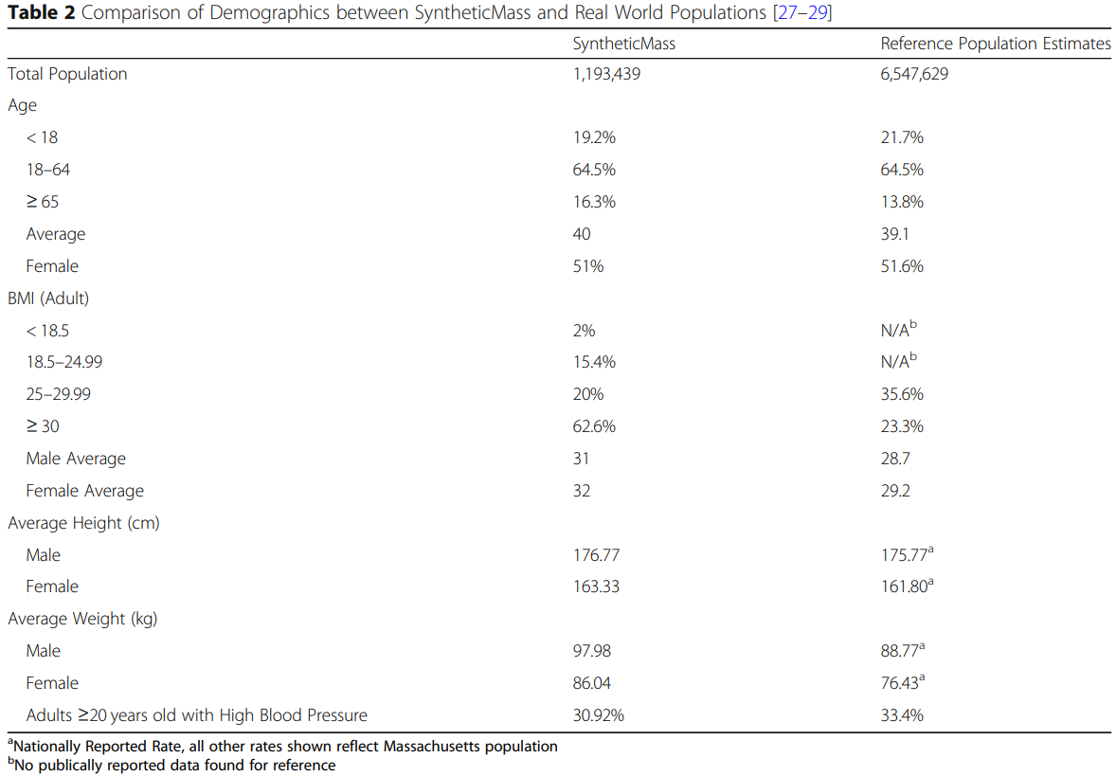
Chen et al. Table

Slide 10
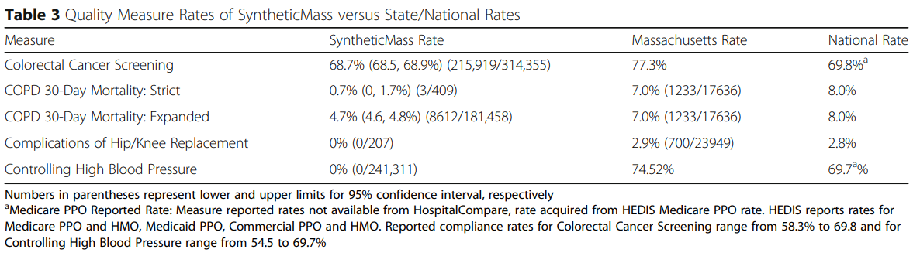
Chen et al Table

Slide 11
Code Demo
Diabetes Health Indicators Dataset | Kaggle
MOSTLY AI
Diabetes_Original.ipynb - Colaboratory (google.com)
Diabetes_Synthetic.ipynb - Colaboratory (google.com)
Notes:
Here is a graph which we think helps explain this concept. In this graph, the x axis is the value of the beta coefficient and the y axis is the sum of squared residuals or general error terms value of the model. As you can see, we start with an initial random value, and then choose a new w value until we reach the minimum point of the curve. The w value of where this minimum point occurs then represents the best model for our training data.

Slide 12
Future Developments & Concerns
Healthcare data in development of DL models is associated to challenges of personal data and regulatory issues
Synthetic date
improves machine learning model accuracy
enables prediction of rare diseases
enables data collaboration
Notes:
There are many future developments we can think about with the use of synthetic data in healthcare.
A huge current challenge in healthcare has to do with personal data privacy, data leakage, and regulatory issues.
The future development of synthetic data in healthcare can address these challenges.
Synthetic data can improve machine learning model accuracy by increasing the training dataset size, without violating data privacy.
It can also enable the prediction of rare diseases. Synthetic data can create a control group for clinical trials that may lack in existing data to enable a prediction.
Finally, synthetic data enables data collaboration. Using synthetic data can facilitate sharing this work between hospitals, as well as medical and pharmaceutical institutions, without breaking privacy regulations.

Slide 13
Future Developments & Concerns
Synthetic data is affected by the quality and accuracy of the source
Synthetic data must "fairly" represent minority subgroups
Use of synthetic data may raise legal issues
Notes:
There are also concerns we wanted to touch on briefly.
As we know the quality and accuracy of the source that synthetic data is trained off affects its validity.
Following this point the data should represent minority subgroups fairly.
Finally, there is the concern of legal issues with its increasing use. This could relate to intellectual property, liability, or data ownership. For example, if it is used to develop a new drug or medical device, and there is an unforeseen side effect.
These are a few future concerns to be aware of with synthetic data in healthcare.

Slide 14
https://pubmed.ncbi.nlm.nih.gov/36623830/
https://pubmed.ncbi.nlm.nih.gov/34573790/
https://bmcmedinformdecismak.biomedcentral.com/counter/pdf/10.1186/s12911-019-0793-0.pdf
https://medinform.jmir.org/2020/7/e18910/
https://ieeexplore.ieee.org/abstract/document/9138552/authors#authors
https://www.kaggle.com/datasets/nareshbhat/health-care-data-set-on-heart-attack-possibility
https://mostly.ai/

